Slide 1
Final Presentation of WDS Design
Amos - Hall - Nguyen

Slide 2
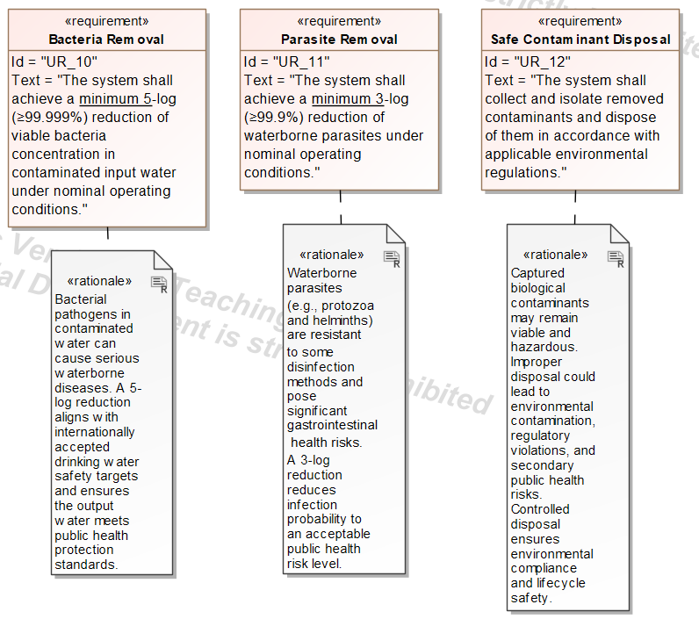
User Requirements
Bacteria removal for safe water.
Parasite removal to reduce infection risk.
Secure, regulation-compliant disposal of contaminants.

Slide 3
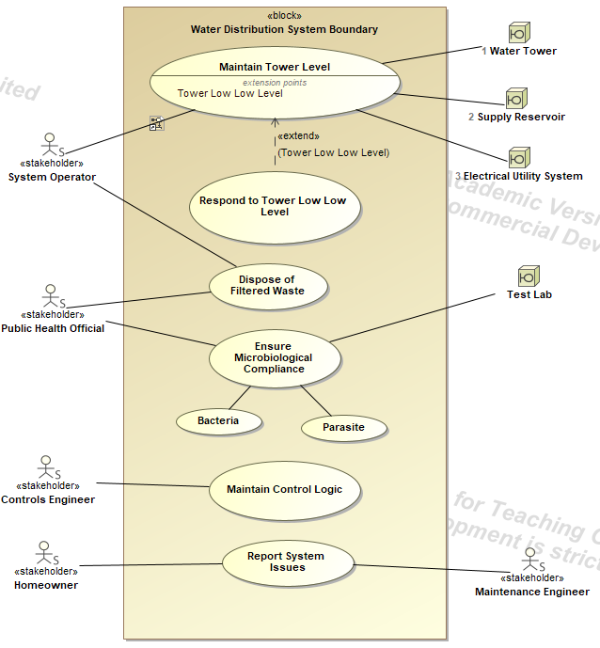
Use Cases
Safety and Public Health: The system ensures water quality by managing microbiological compliance (specifically targeting bacteria and parasites) and overseeing the disposal of filtered waste in collaboration with public health officials
System Automation and Logic: A dedicated use case for maintaining control logic allows Controls Engineers to manage the technical parameters and automated behaviors of the distribution network
Stakeholder Feedback Loop: The architecture provides a clear path for maintenance, allowing Homeowners to report system issues which are then triaged and addressed by Maintenance Engineers.

Slide 4
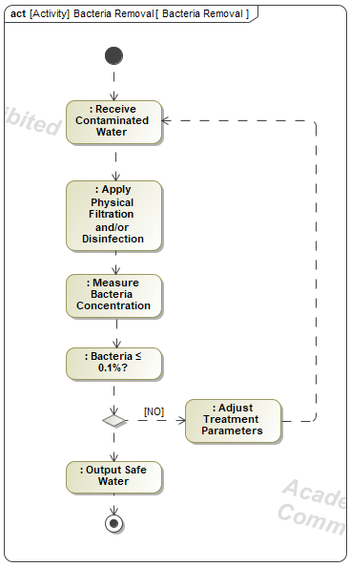
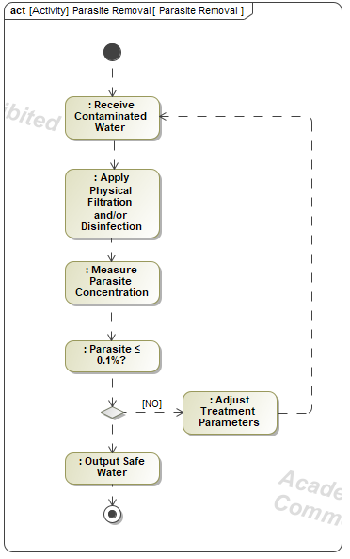
Filter Activity Diagrams

Slide 5
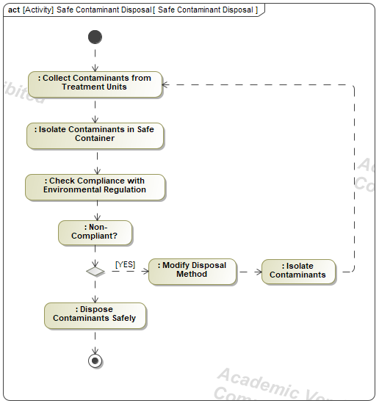
Contaminant Disposal Activity

Slide 6
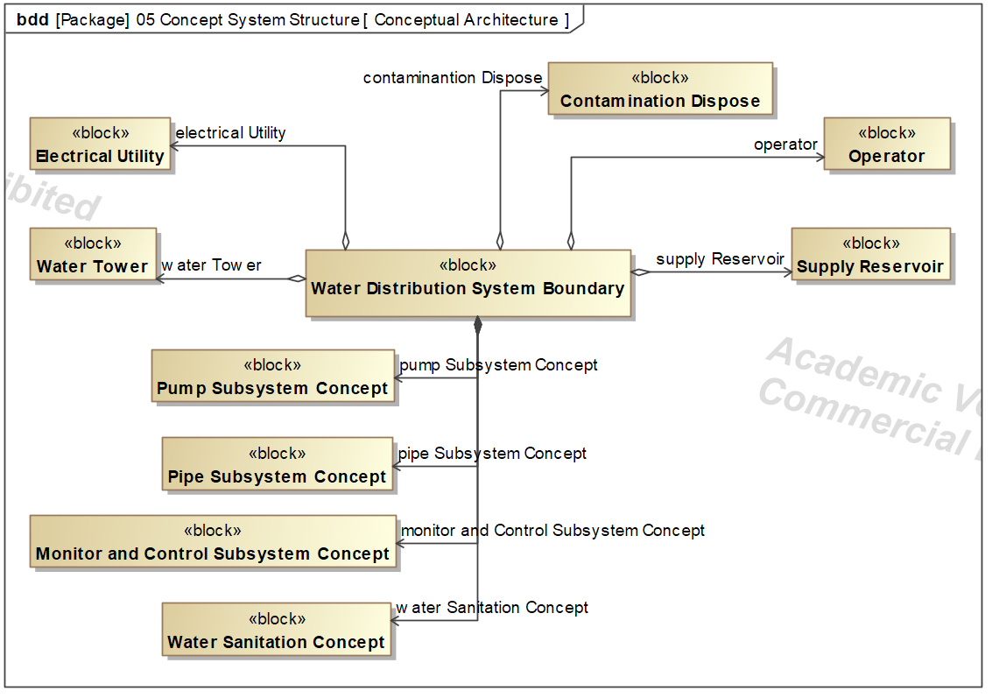
System Concept

Slide 7
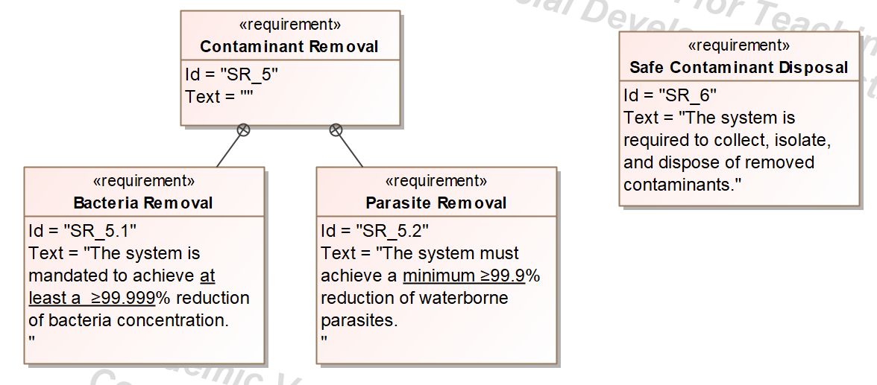
System Requirements

Slide 8
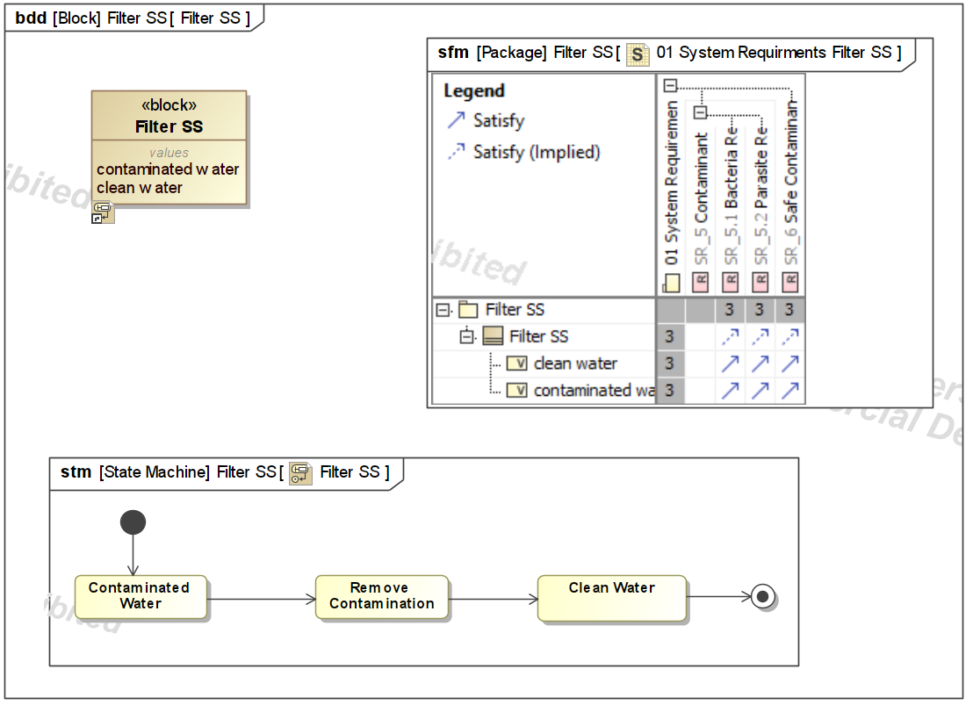
Filter Sub System

Slide 9
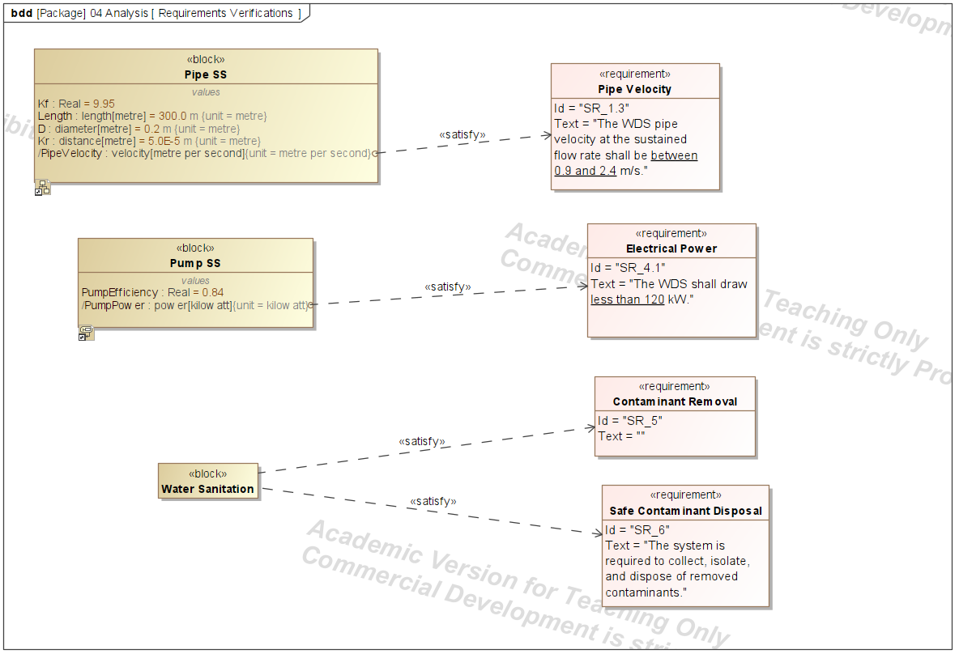
Satisfying Requirements

